Slide 1
COMMON TYPES OF CYBERTHREATS &CYBERBULLYING
Cyberthreats gain unauthorized access to computer systems, networks, or data. They can come from individuals, groups, or even nation-states and vary in complexity and intent.eg.
Malware , spyware ,phishing , adware ,hacking, ransomware etc.
Some other common types are :
Type
Trojan Horse | Harmful software that looks safe.
DoS Attack | Crashes a website by sending too much traffic.

Slide 2
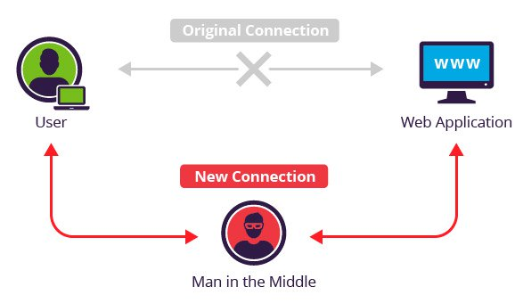
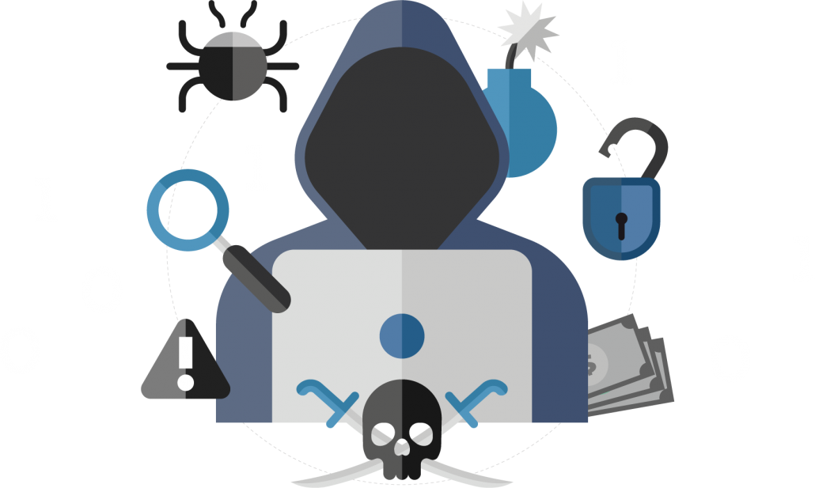
Man-in-the-Middle (MITM) Attack
When a hacker secretly comes between two people (or a person and a website) who are communicating, and reads or changes the information without them knowing.
SQL Injection
A type of attack where a hacker puts special code into a website’s form (like a login or search box) to trick the website into giving access to secret data — like passwords or personal info.
Advanced Persistent Threat (APT)
A long-term cyberattack where a skilled hacker secretly enters a computer system and stays hidden for weeks or months — to steal important information slowly without getting caught.

Slide 3


CYBERBULLYING
Cyberbullying is when someone uses the internet to hurt or embarrass others.
Type | Simple Meaning
Harassment | Repeated insulting or abusive messages.
Impersonation | Creating a fake account using your identity.
Constantly following and messaging
someone online.
Cyberstalking
Doxing | Sharing private info without permission.

Slide 4


Password ATTACKS
Password attacks are ways hackers try to steal or guess your password to access your accounts. There are two main types:
Electronic Attacks = physical tricks (shoulder suffering, dumpster diving , social engineering)
Active Online Attacks = software/tools that guess or steal your password.(Dictionary Attack, Brute Force Attack , Rule based Attack, keylogger)
How to Stay Safe Online
Use strong passwords
Don’t click on unknown links
Report or block suspicious accounts
Let’s be smart and kind digital citizens.”

